Slide 1
KINVER HIGH SCHOOL
Engage, Succeed, Aspire to Lead
Level 3- EPQ Project
120 learning hours
Mrs N Clifton - Headteacher

Slide 2
So - What is the EPQ?
The Extended Project Qualification – is a Level qualification by AQA
It’s a free-standing qualification equivalent to an AS level and graded A* to E.
You choose and design your project.
You get to explore a further aspect of an A-level subject that you are already studying or will study
OR choose a topic that you have a personal interest in.
• The finished project can be a purely written report OR an artefact (something you have produced to fit a design brief).
• The project is finally presented to a non-specialist audience.
According to University of Manchester: The skills that students develop through the Extend Project Qualification (EPQ) are excellent preparation for university-level study. Students can refer to the EPQ in their UCAS personal statements and at interview to demonstrate some of the qualities that universities are looking for. For you, you can finalising it in 6th Form or College & we can accredit it May 2022!

Slide 3
The Extended Project
It is supposed to take about 120 hours to complete.
The EPQ could be :
An essay (5,000 words),
OR
A production / performance
An ‘artefact’ / A presentation / exhibition and a 3,000 word report
It is marked at A2-level, using higher order skills like analysis and evaluation rather than just describing and narrating.

Slide 4
EPQ Project Titles from the Past
What are the factors behind England’s failure to win a recent major footballing championship?
To what extent have the volcanic eruptions of Montseratt and Mount St Helens differed in their economic, social and environmental impacts?
To what extent was America to blame for the 9/11 attacks?
What effects do video games have on modern society?
To what extent has mobile phones changed the way we live?
In an increasingly energy dependent world is nuclear power the preferred successor to fossil fuels?
Has the rise in hate crime in the 21st Century been a result of an increased use of Social Media?
What is the likelihood of hydrogen becoming the fuel of the 21st century?
Which Mathematician has had the most effect on history?
Margaret Thatcher’s Prime Ministership Reign and the birth of the Recession, to what extent are the two interrelated?

Slide 5
What do you need to do to pass?
Students are required, with supervision, to:
choose an area of interest
draft a title and aims of the project for formal approval by the centre
plan, research and carry out the project
deliver a presentation to a non specialist audience
provide evidence of all stages of project development and production for assessment.
Staff will support you with this remotely via email
Any student who wishes to complete this can contact Mr Fox via email [a.fox@kinverhigh.co.uk] on Wednesday mornings [9.30-11.30am] for advice or to check through existing paperwork
However, you can ask any member of staff for subject specific guidance should you need to!

Slide 6
What do you need to do to pass?
There are FOUR assessment objectives that you are marked on:
1.Managing a project yourself
2.Using resources you have selected
3.Developing and realising a project
4.Reviewing the project

Slide 7
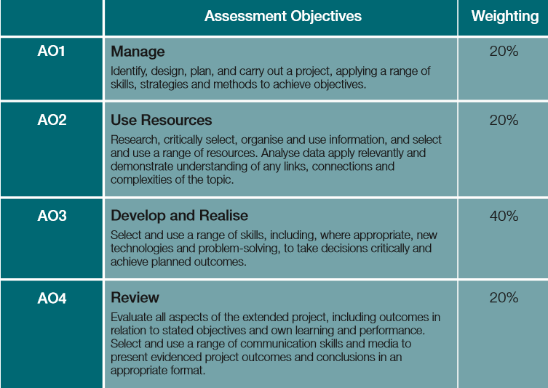
Assessment Evidence
The evidence for assessment will comprise the following:
the completed Production Log and Assessment Record including the Project Proposal Form, Presentation Record and Candidate Record Form
the project product including a written (5000) report and any other evidence, as appropriate, depending on the topic or subject area chosen.

Slide 8
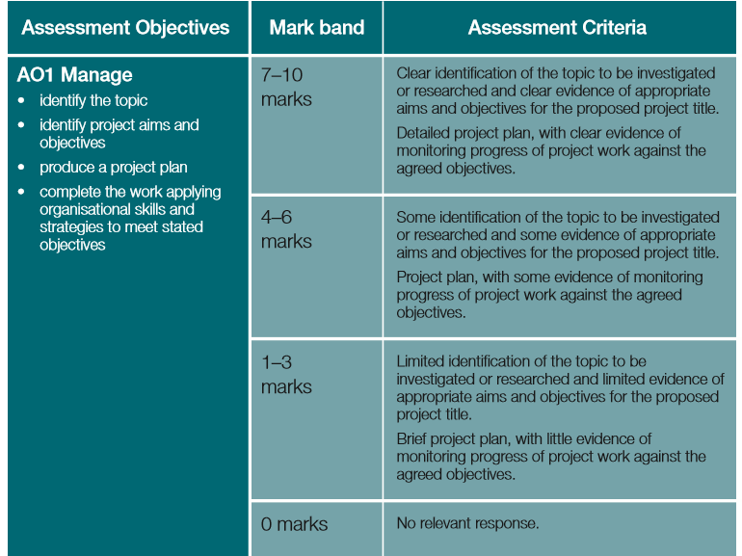

Slide 9
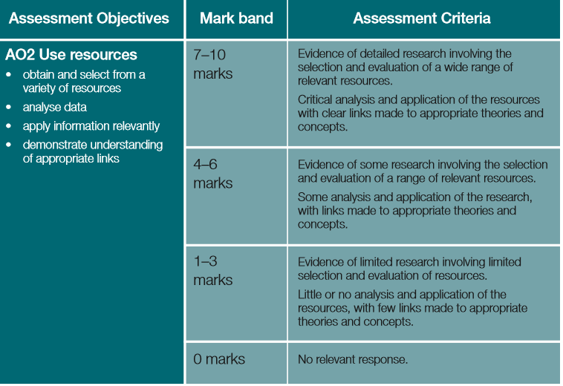

Slide 10
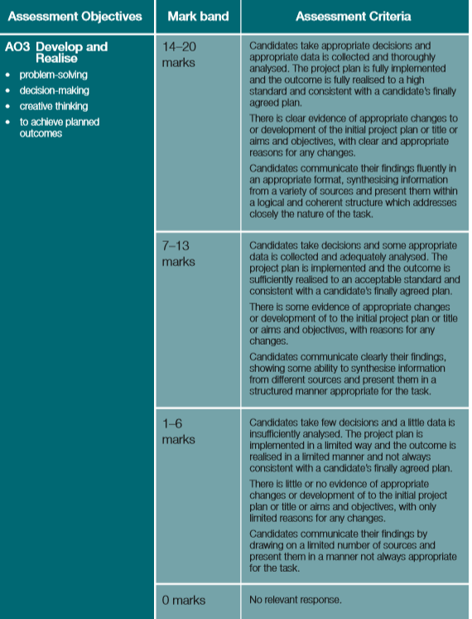

Slide 11
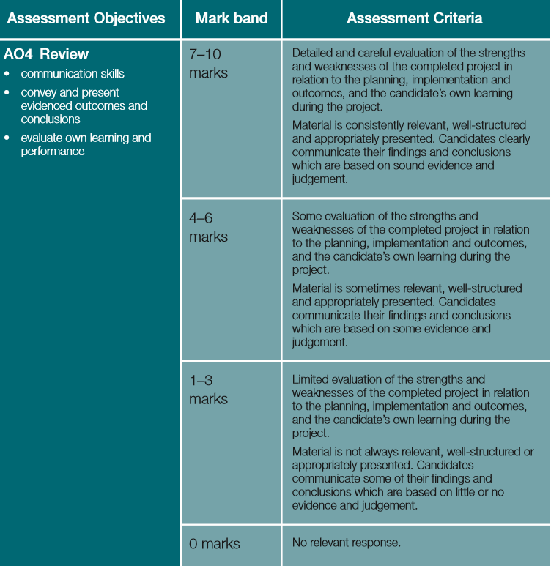

Slide 12
The Extended Project – Why Bother?
Extra UCAS points
Gives you the advantage at interviews
Makes you a more interesting person
Universities love it!
Your chance to pursue a passion and get a qualification for it!
Great for study skills development- will help with undergraduate study later on.

Slide 13
Evidencing the Project – Gaining the Marks
You’ll need to keep a record of the PROCESS and evidence the following:
Record your Initial Project Ideas on a document
Complete a Project Proposal Form – (sent to a teacher for feedback)
Complete a Planning Review Document
Complete a Mid Project Review Form (30-50 hrs in)
Complete a Project Product Review Document (5000 word essay or 3000 word report & artefact)
Deliver a Final Presentation to discuss your finding and talk people through your research & project process!
Keep a log of everything / research / findings etc

Slide 14
KINVER HIGH SCHOOL
Engage, Succeed, Aspire to Lead
Level 3- EPQ Project
Documents to complete / examples
Mrs N Clifton - Headteacher

Slide 15
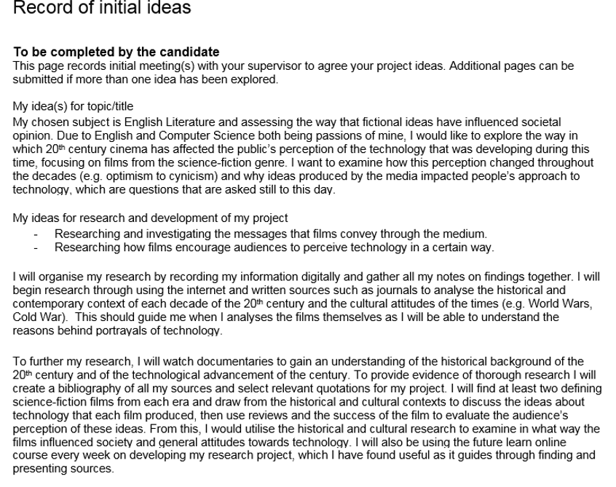
Record your Initial Project Ideas on a document

Slide 16
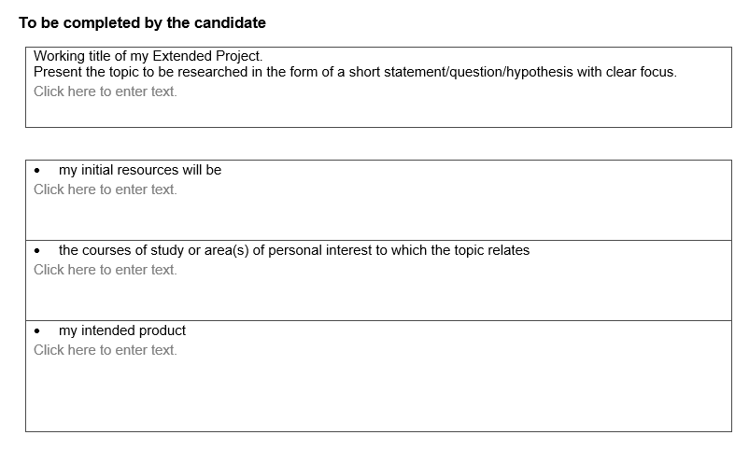
Complete a Project Proposal Form – (sent to a teacher for feedback)
What resources are you going to use to research this? Online Articles? Books? Magazine Articles? Etc.
What school subjects could this topic of interest be linked to? (I.E. History, Sociology, Media Studies etc.)
What are you going to produce at the end of the EPQ?
5000 word essay?
Performance/Production? [Like a PowerPoint Presentation that you will present to a group as proof]
An artefact and a 3000 word essay?

Slide 17
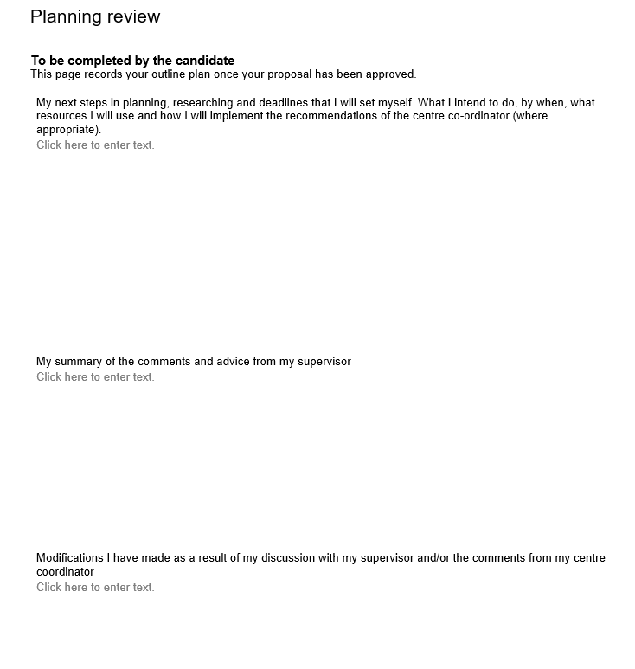
Complete a Planning Review Document

Slide 18
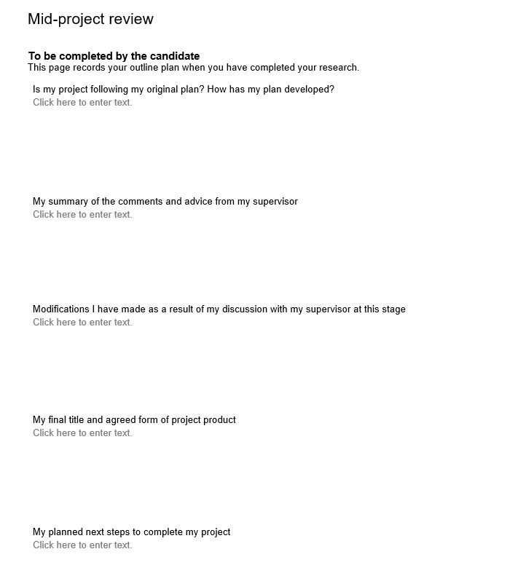
Complete a Mid Project Review Form (30-50 hrs in)

Slide 19
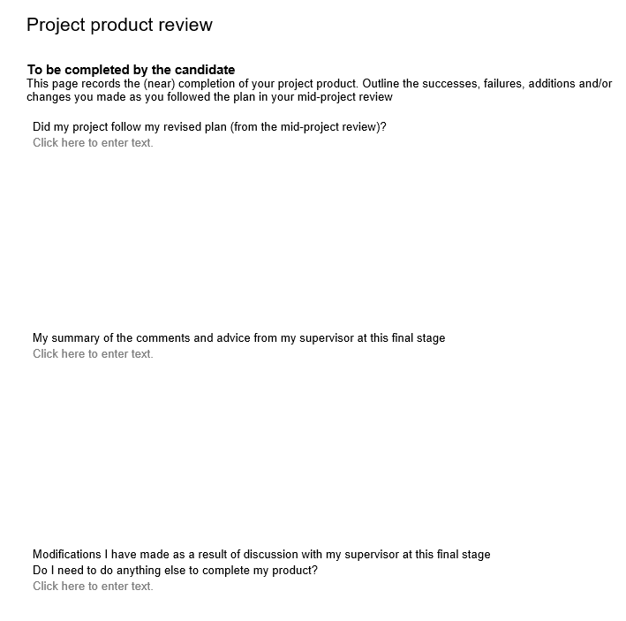
Complete a Project Product Review Document before doing the 5000 word essay or 3000 word report & artefact

Slide 20
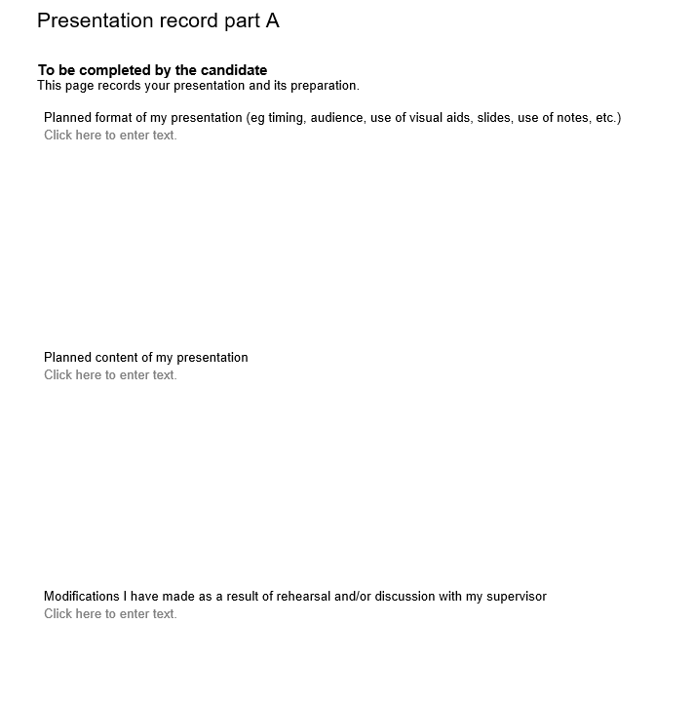
Final Presentation Plan

Slide 21
Deliver a Final Presentation to discuss your finding and talk people through your research & project process!
The live presentation should be for a non-specialist audience and use media appropriate to the type of project. The presentation may involve the use of flipcharts, posters, Prezi, PowerPoint or short excerpts of video material. The presentation record evidence should include examples of questions from supervisors and the student’s responses to these.

Slide 22
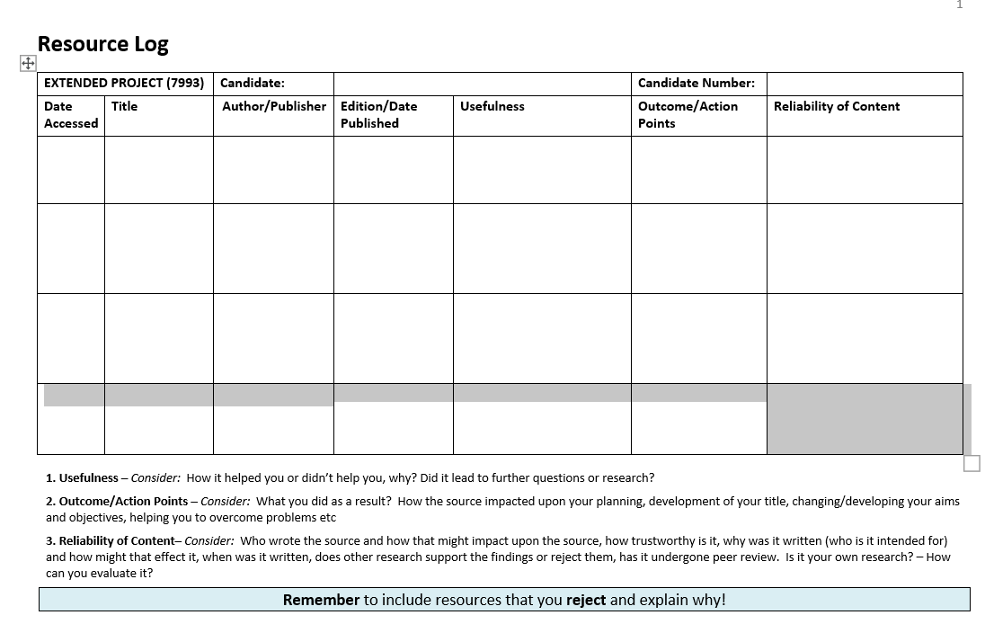
Keep a log of everything / research / findings etc

Slide 23
KINVER HIGH SCHOOL
Engage, Succeed, Aspire to Lead
Level 3- EPQ Project
Example Final Presentations
Mrs N Clifton - Headteacher

Slide 24
The power of technology and the affect it has on our privacy

Slide 25
Choosing my question
Technology based:
The design of computers and the impact computers have on our lives
The design of digital cameras and the use of it within law enforcement
To what extent technology invades our privacy and the benefit it has
My question first and final question:
To what extent are technological improvements invading our privacy and how is this progression of technology justified?.
Notes:
Computers:
Talk about how CAD/CAM is all through the use of computers
How CCTV cameras has a huge impact on surveillance (evidence for court cases etc)
Quick overview of the general power of technology and its CAPABILITIES also mention the security dead-zones with a few examples of surveillance

Slide 26
Planning
My original idea was to research the way technology may or may not have an affect on our privacy and to what extent.
My aim was to gather analytical information from surveys to discover what people think and the knowledge they have on the rapid progression of technology and its abilities.
I was also hoping to cover a lot of surveillance techniques
I soon decided to only select a couple of main/important surveillance techniques as these could be wrote about in great detail being the most popular
Was hoping to prove a point that technology is never 100% safe
I
Notes:
Research about the most used surveillance techniques and what they are used for
To produce surveys that would give me an idea on what the public think
I soon went away from wanting to research on lots of surveillance techniques…. I chose only a couple of the majorly used techniques and spoke in detail for each.
I wanted to make a strong point that technology is never safe and to produce evidence on this

Slide 27
What my project entails:
General information and stats on surveillance technology
Where this technology is used and how
Whether this technology is deemed as helpful and useful
A public survey to gather general views and to obtain a rough idea of the knowledge of the public in regards to the power and safeness of technology.
My own experiment to see if I could trace someone down to their exact home address
Notes:
e.g. the cost of the technology → CCTV - £250m spent between 2007 and 2011 and £4-5 billion being spent on the installation from 1994-2004
General info on the positioning of the surveillance → built up areas, areas that appear venerable e.g. banks, town centers, shop fronts.
Advantages and disadvantages…. → talk about how the police use it as a large benefit… ANPR (can track any vehicle of their choice (particular criminals), evidence of a crime or offence… used in court.
Primarily to gather the public’s view on the technology, whether they think its useful or not, whether they feel at threat by the suspected privacy invasion…
I conducted my own experiment… aim was to see how easy it was to do or if actually possible… mention what I found…. FOUND THE HOME ADDRESS OF THE INDIVIDUAL… easy enough for people with moderate computer knowledge to do.. MENTION HOW MUCH OF A THREAT THAT IS…..

Slide 28
My research
I gathered research from numerous sources. These included:
UCS articles
Government/official websites
Other unofficial websites
General Knowledge
What I used the most
Websites was my most used source for factual information.
Information gathered from UCS was in great detail of how the technology worked e.g. ANPR told me how it was connected to a national database and the physics behind it that calculated speed
Notes:
What I used the most:
I used websites the most as it contained a variety of information from stats to analytical opinions.
I used government and unofficial websites that all had legitimate information – in some cases I researched about one topic numerous times to see if other websites contained similar informatiom
Rarely used UCS information as it was focused more on the smallest details of how the technology works (a lot of writing regarding the algorithms and in-depth analysis of how the technology works)
A lot of my info was from general knowledge, but made sure I looked up what I thought was right just to have a source at hand to prove my point
UCS contained a lot behind the physics of how ANPR worked to calculate speed (example)

Slide 29
Evaluation of sources
How useful were they?
Websites:
Websites made up the majority of my research
A lot from government and police websites, as well as unofficial but legitimate websites
UCS articles:
Very useful and official, contained a lot of detailed information, but only helped me on the descriptive side
Notes:
Websites: made up the majority of my research. I used a lot of government and police websites, as well as unofficial but legitimate websites
UCS: Very useful and official, contained a lot of detailed information, but only helped me on the descriptive side

Slide 30
My Survey
I constructed a survey to gather information on the knowledge individuals have on the power and potential thread of technology
I produced two questions
One to gather their knowledge on the subject and another on their views on the progression of technology
How much do you know about the technology that exists that maybe invading your privacy? (Such as, Number Plate recognition CCTV cameras, GPS, ATM machines
Notes:
This gave me a lot of analytical information to support my point
This strongly supports my point that older people are at much higher risk of attack due to their lack of knowledge of modern technology
This again helps me as it supports my point that younger people use technology to its full extent e.g. social media.

Slide 31
What I found out
I primarily found out about the uses of technology and the powers they have.
I researched the advantages and disadvantages of different types of technology and where and why it is used
I gathered information from my survey that gathered peoples views on technology and their views on the power of it.
I found out that older generations lack knowledge of the sheer power of technology.
In connection, I found out that younger people appear to have much more knowledge on how technology works
Notes:
The power of technology and the threats
How it is affecting us and the fact there is too much technology to all be properly maintained and secure
I gathered the opinions from members of the public to hopefully support my points
Mention how older generations are of much higher risk due to the technology not being around when they were brought up
Talk about how younger people were brought up with it and should maybe naturally have more knowledge on the operation of technology

Slide 32
Problems I had
Gathering evidence to support my point that I wrote based on my general knowledge. Often, it was finding evidence for stats.
Adding analysis: I could write factual and descriptive writing relatively easy, but I found writing analytically quite difficult.
Balancing my primary topics equally.
Notes:
Talk about how I couldn’t always find a reference for a point I made from my knowledge
Adding analysis: I found that it took me a long time to gather enough responses for my survey – especially for the older generation
I over come this by simply waiting to get a sufficient amount of responses… Didn’t want to rush and gain poor/inaccurate results
I found it much easier to gather information from the younger generation…
I found it hard at times to write equally on my primary topics (CCTV, ANPR, Location data etc…)

Slide 33
What I learnt
I learnt the true powers of technology and the idea that anything can be traced. I also learnt about how a rather large amount of the public are actually unaware of the powers of technology and suggesting that a lot of people may be venerable, especially older people.
Time management
Recording findings
Notes:
I learnt:
I learnt much more about the power of technology and how it is used all the time in everyday life
I learnt how the public seem to be too unaware of the capability of modern technology (largely shown in my survey)
I learnt how to time manage: Balancing work out so it was all complete to of good standard. Working on each piece of work (essay, logbook and presentation) each week so it was all being completed as I went along. (started the PowerPoint towards the end)

Slide 34
Skills I gained
How to work independently
An increase of my essay writing skills
How to filter through large texts to find relevant information
How to assess my work and remove un-necessary information
Notes:
Learnt how to work independently both in researching and in essay writing
Improved my essay writing skills
Filtering through very large texts and websites to find information that’s necessary
How to review my work back over and remove information that may not support my point enough or may be of no relevance

Slide 35
What I would do differently if I were to do EPQ again
I would conduct more surveys with different styled questions
I would try to add more surveillance techniques and mention how each technique has been used for prevention of large crimes
Write in more detail about information that complex and is hard to understand
I would do a range of analytical research rather than just surveys e.g. interviews
Notes:
I would definitely conduct more surveys with different styed questions – possibly… questions to find out if any of this technology has been used against themselves or someone they know
I would research much more into crimes that have been committed where technology has played a massive part in the evidence stage and/or prevention - which would allow me to talk about how it IS useful in certain situations
I would write in more detail in topics that may be of a high complexity level e.g. how CCTV is used and maintained through national databases
I would complete interviews as well as surveys to gather detailed information in a ‘1 to 1’ or a ‘1 to 2’ interview

Slide 36
Conclusion
I think that my findings are valid throughout my project. Possibly only valid to a level that relates to urban areas and may possibly be much different in rural areas
I believe I have found information from many different point of views relating to things like age group
I think that my surveys supported my point heavily as the analytical information gave me an opinion from people I met rather than relying on the internet for findings
Notes:
All my info was valid in terms of in urban areas, but may not be that accurate when talking about rural areas
This could possibly leave me with only partially accurate information
Finding analytical information from a range of point of views like age group
My survey has helped me to support my point……. Information from people I met rather than random information from the internet

Slide 37
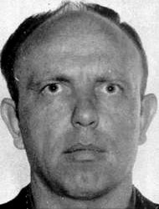
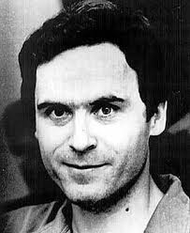
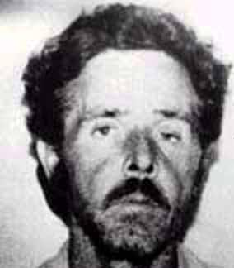
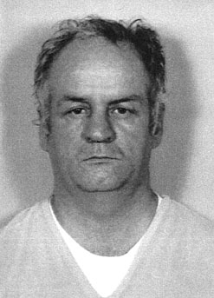
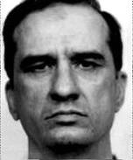
Serial killers
The Argument of Genetics vs. Environment
Notes:
My extended project was on the argument of nature vs. nurture when it comes to what makes a serial killer.

Slide 38
Choosing My Question
Area of personal interest
Plans for university and a career in law or criminology
Notes:
Before starting the extended project, you obviously have to choose a question to study. I thought it to be very important to pick a subject area that I was very interested in as the project takes up a lot of time and this would mean I enjoyed researching and writing my report rather than getting tired of it. My interest in the subject or serial killers initially came from watching a documentary on serial killers and noticing a significant trend in the type of upbringing all the subjects had. This made me start to question whether in one way or another, childhood trauma can be to blame for serial murder or whether it is more a result of the genetics of a person, so are they destined to become a serial killer from birth. As well as being an area or personal interest, I was also at this time looking into going onto a university course in law and criminology and therefore thought this would be a way of showing my passion for the subject.

Slide 39
Initial Changes
‘Born or Made?’
‘Nature or Nurture?’
‘Genetics vs. Environment’
Notes:
Once I knew my the area I wanted to investigate I had to settle on a question. My initial question was ‘Are serial killers born or made?’, meaning are people born to become a serial killer regardless of other factors, or are they made into a killer through their experiences and environment. However, after discussions with my supervisor and beginning to research, I found that it would be extremely difficult to distinguish between psychological factors that are present at birth and those that develop over time due to other factors. I therefore decided to change my title to ‘Nature vs. Nurture’ but again found it may still be difficult to distinguish between these factors, and also that this would mean my project was more based around the psychology of a killer, which was not necessarily the direction I wanted to go in. Finally, I decided to change my title to ‘Is serial murder a result of genetics or environment’ as not only would this mean my project would be more balanced with a clear distinction between factors, it also ensured that I was able to look into the biological factors as well as the psychological ones.

Slide 40
How I Carried Out My Research
Online Articles
Books
Academic Journals
Interviews of Serial Killers
Notes:
Starting to research for the extended project can be a daunting task as there is such a vast amount of information out there, a lot of which can have little relevance or make very little sense at first. I decided the best way to start my research was to start with more simple sources that are written for a mass audience who are not necessarily an expert in the field of criminology. The best source I found for this stage was a book called ‘Talking With Serial Killers’ which included several cases of serial murder and the environmental and biological factors around them. Although it was written for the mass market, the author was an expert in the field of criminology and therefore it contained some very useful information for my project. Once I had a foundation into what I was looking for, I could then start looking into more complex sources such as academic journals and specialist websites for more in depth knowledge. One thing I found particularly useful was our school trips to the University of Hertfordshire and University Campus Suffolk who gave us access to their student library where I managed to find some extremely useful sources that otherwise may not have been available to me.

Slide 41
What I Found Out
Environmental factors have an impact on the crimes carried out
The hypothalamus in the limbic system can create abnormal feelings and desires if damaged
XYY syndrome can cause increased criminal behaviour in men and increases the risk of someone developing mental behavioural disabilities or abnormalities
Kryptopyrrole found in elevated amounts in the blood can be a biochemical marker of psychiatric dysfunction and can result in Pyroluria. Pyrolurics are unable to handle anger and suffer from mood swings so can constitute a risk to the public.
Notes:
I made several interesting findings throughout my extended project, some of which were completely new ideas to me. Firstly on the environmental side of my argument, I found that almost all the case studies I looked into had a history of terrible childhood backgrounds which often had an affect on their crimes. Harvey Louis Carignan for example who killed up to 50 women and assaulted many more, had no solid family roots a child and was physically, mentally and sexually abused by almost all of the female figures in his life. Experts are now in agreement that this was to have had a massive impact on his crimes as he continuously killed older women thought to be in the figure of his mother or grandmother whilst despite still carrying out horrific assaults, he let a lot of his younger victims live. As well as this, psychologist Lunde did a case study in 1976 on serial murder in which he provided a model for the development of a sexual sadist serial killer, which claimed that childhood trauma begins the process. It is now so commonly agreed upon that environmental factors play a role in the making of a serial killer, particular as a child that the FBI has have published a list of 13 ‘Family Background Characteristics’ which in their studies of serial murder they have found adversely affect a child’s later behaviour.
As well as this however I also found several interesting genetic factors that have been proven to contribute to the making of a serial killer. One of these is damage to the part of the brain called the hypothalamus in the limbic system. The role of this area of the brain is to avoid harmful or unpleasant situations and seek and maintain the experience of pleasure. For example, if the hypothalamus experiences pleasure, in the case of most serial killers from sadistic sex or murder, it will switch on ‘reward’ feelings which encourages the person to continue engaging in the activity. This is the case in everyone. If these limbic needs go unmet, the individual will experience depression, anger and in some cases can even result in a homicidal rage. When the hypothalamus seeks pleasure and satisfaction the signals it sends out leave no room for consideration or understanding of the long-term consequences of its acts or for any sense of morals of logic, even in perfectly normal people. If the limbic system is physically damaged, feelings of love, hate, affection and sexual desire may be abolished or can become severely abnormal which is thought to be the case with some serial killers. A review of brain abnormality studies by Pallone and Hennessy in 1998 found that in samples of homicide offenders and other violent criminals, along with persons who had been the victims of child abuse, much larger percentages had indications of brain damage than have been found among the general population.
Another biological factor that can contribute to the making of a serial killer is XYY syndrome. This is a condition in which a male has an extra Y chromosome. This abnormality has been consistently linked to homicidal and violent behaviour and studies report that the XYY male has a 10 to 20 fold increase in his lifetime risk, as compared to their incidence in the population, of being institutionalised in a mental hospital or prison. Arthur Shawcross was the only serial killer I looked into that had a relatively normal upbringing but it has been shown that he suffers from XYY syndrome. Shawcross killed 2 young children and 11 women, despite coming from a normal family in which homicidal and criminal behaviour were very much the exception. It is argued therefore that his XYY abnormality played a reasonably large role in his transition to becoming a serial murderer.
As well as this, Shawcross was also found to have an extremely high amount of the chemical Kryptopyrrole in his blood and it is now thought that this also can contribute to anti-social behaviour. Although little is known about this chemical, it has a chemical structure to other chemicals which can be toxic to brain functions and it is now considered to be a biochemical marker of psychiatric dysfunction. As well as this, when Kryptopyrrole mixes with vitamin b6 and zinc in the blood it can result in Pyroluria. Pyrolurics appear to suffer poorly outside controlled conditions, such as an unstable home life (which could be the case with Shawcross) and are unable to control anger once provoked, suffering from mood swings and a diminished ability to handle stress. These are all traits that are common within serial killers and as such, Pyrolurics can be very dangerous and constitute a risk to the public.

Slide 42
My Conclusion
Environmental can play a huge role in the
making of a serial killer.
HOWEVER
Many people around the world suffer from similar
maltreatment and do not resort to murder
The genetics of a person are the more important factor
HOWEVER
It seems that the making of a serial killer is, in most cases,
a deadly mixture of the two.
Notes:
My conclusion was more difficult to draw than I had expected, as using the evidence I had gathered it was easy to see that the making of a serial killer is extremely complex and it is therefore difficult to attribute the blame onto one factor. It was clear to me that envrionmental factors do play a large role in a persons later behaviour, but I thought it important to take into consideration the many people around the world who suffer from similar upbringins and do not become serial killers. This means that although childhood and environment does play a role, when deciding which is the most prominent factor in the making of a serial killer it is more reasonable to look at the psychological and genetic factors. The most significant genetic factor I found is the damage to the limbic system which can lead a person to have uncontrollable urges. This is thought to be the case with serial killer Michael Bruce Ross who, although he knew the difference between right and wrong, said he was ’unable to stop’ killing. However, damage to the limbic system, despite being a genetic factor can often be triggered by a person’s environment which suggests that the two factors are entwined. Therefore, I would say that although genetic factors are more prominent in the making of a serial killer, ultimately in most cases it comes down to a deadly mixture of both environmental and biological elements.

Slide 43
Successes
Organisation
Research Skills
Knowledge
Notes:
I think one thing that I did successfully over the course of my extended project was my organisation and time management. I was able to keep to all my deadlines and did not have to rush around last minute to complete things. As well as this, despite the amount of information I found when researching my topic I thought that I did well at cutting down sources and just using the most important, relevant and valid ones. Also, I think my extend project has gave me a wider range of knowledge in this area which may benefit me should I go on to do criminology in the future.

Slide 44
Problems I encountered
Volume of evidence /research documents
Lack of distinction between genetic and environmental factors made coming to a conclusion difficult
Notes:
One problem I encountered when doing my project was, as I mentioned before, the sheer volume of information I found when doing my research. I overcame this however by assessing the relevance and validity of the sources and taking only the ones that would be of the most use to me.
As well as this, I also found that it was quite difficult to differentiate between genetic and environmental factors which made drawing a conclusion difficult and also could mean that other people have a different interpretation to mine.

Slide 45
Overall…
Pleased with my project
If I was to do it again:
Referenced better as I went through
Kept my sources more organised
What I learnt:
How to research and reference
Time management and organisation
Presentation skills
Notes:
In general I was pleased with my finished project, however if I was to do it again I may make a few changes. For example, although I did my best to reference throughout, when I had finished I had to go back and make some changes and add in more sources which was a bit of an inconvenince. As well as this I would have kept the material I found to use throughout my essay more organised as it made it difficult when writing up to go through everything to find what I was looking for. Despite this however I think the extended project taught me some new key skills such as how to research and reference, time management and organisation and presenting my findings to a large audience. All things that will benefit me in the future.

Slide 46
KINVER HIGH SCHOOL
Engage, Succeed, Aspire to Lead
Level 3- EPQ Project
Good Luck!
Mrs N Clifton - Headteacher

